Slide 1
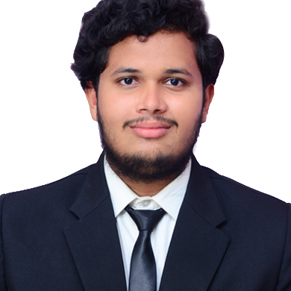



Upendra Rambarki
Bachelor of Engineering
Information Technology:2018 -2022
Analyst/Software Engineer
Skills
Bangalore
Java 8 /J2EE | Java Basics, OOPS, Generics, Collections, Arrays, Loops, Lambda Exp, Stream API Junit, Mockito.
Spring core | IOC & Dependency Injection, Autowire
Spring REST | REST controllers, Implementation of GET, POST, PUT & DELETE, Bean Validation & Exception Handling, Testing Services, Controller & Repository layer
Spring Data JPA | Implement DAO layer using spring Data repositories,
Spring Boot Microservices | Spring Boot Starters, annotations, Swagger API specifications
Spring Cloud | Eureka.
React | Components, Hooks, Event handling.
Database | MongoDB No Sql.
UI Tech | HTML 5 & CSS 3,JavaScript, ES6 & TypeScript
Tools | Git, Postman, Maven, eclipse,vscode.
Add On skills | Communications, Team management. Peer learning
xxxxxxxxxxx@capgemini.com
+91 9381490982
A4
Java Full Stack Developer
Hands on experience in creating microservices with Spring Boot, Spring Security, Spring Cloud API Gateway, Eureka server.
Hands on experience in creating Single page Web Application in React latest versions.
Hands on experience in connecting mongoDB with spring boot and React
Experience in creating documentation with Java docs and swagger and in unit testing using Junit, Mockito
Java Microservice Development knowledge using Spring boot and spring cloud framework on an intermediate level.
Proficient React developer with working knowledge on ReactJS(Hooks).
Flight Booking System Application
Completed end to end case study of Flight Booking System Application with Spring Boot, React and MongoDB along with JWT authentication, Swagger and implemented testing using Mockito.
Check out my work on GitHub & Video Profile

